Slide 1
Marketing Prediction Analysis
Group 4
Mentor Name : Parth

Slide 2
Contents
INTRODUCTION
PROJECT FLOW
DATA PREPARATION
MODEL BUILDING
MODEL DEPLOYMENT

Slide 3
Objective: Each Salesperson will be assigned with a Target(no of products to be sold) for each months. Which is given to them based on their last month's Achievement(no of products sold) i.e 10% Increased from the last achievement.

Slide 4
Project Flow

Slide 6
EDA(Exploratory Data Analysis)

Slide 7
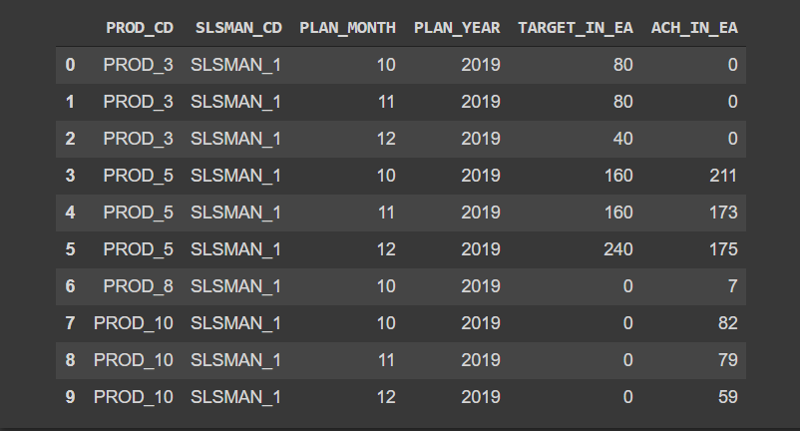
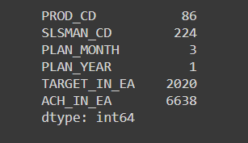
EDA(Exploratory Data Analysis)
Total number of rows – 5840
Total number of columns – 6
Target Variable - TARGET_IN_EA
Unique Values of each variable

Slide 8
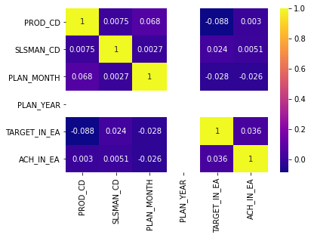
Correlation Matrix
Variable Transformation
“SLSMAN_CD”, “PROD_CD”, “ACH_IN_EA” these variables are converted to numeric.

Slide 9
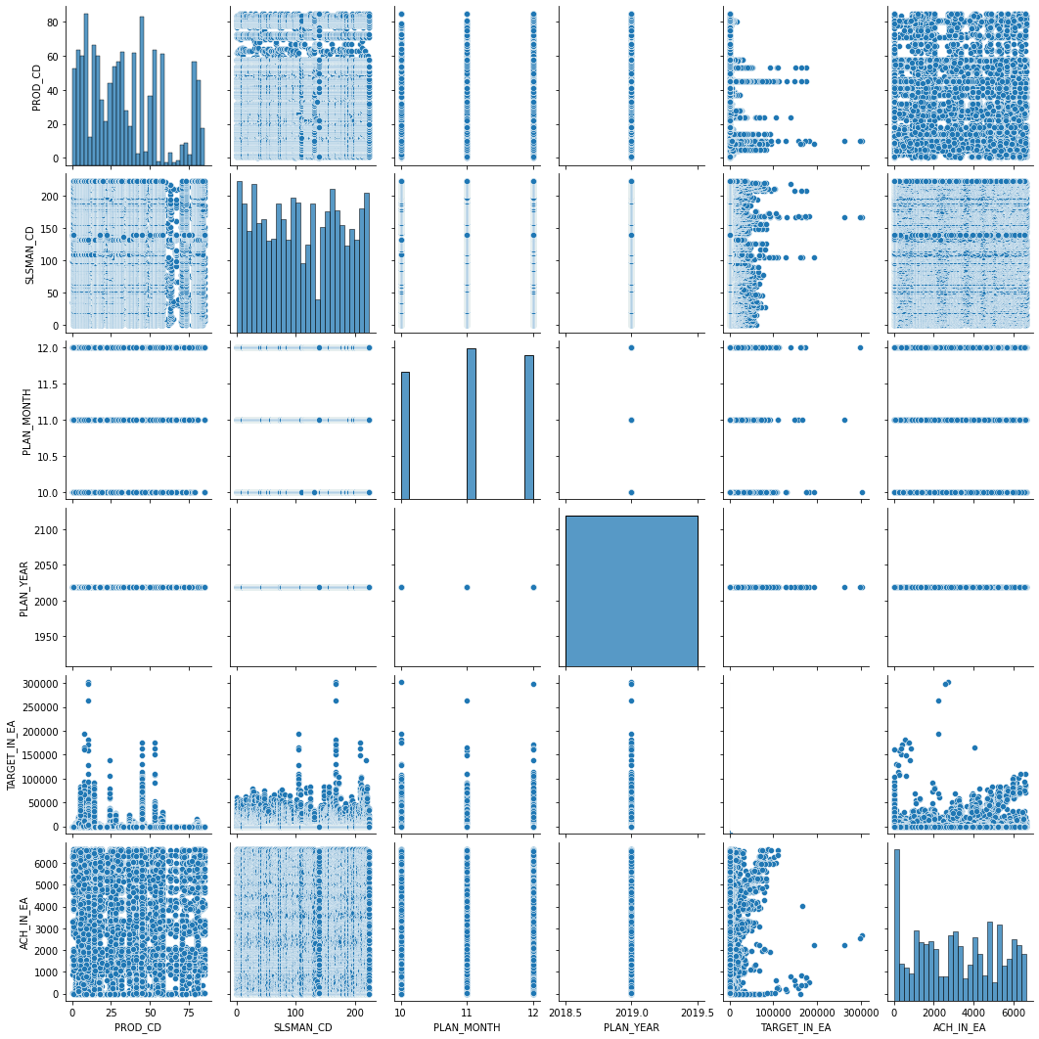
PAIRPLOT

Slide 10
Univariate Graph Description
PROD_CD : There are total 86 Products.
SLSMAN_CD : There are total 224 Salesmen.
TARGET_IN_EA : All unique number of Targets are 2020.
ACH_IN_EA : All unique number of Achieved Targets are 2020.

Slide 11
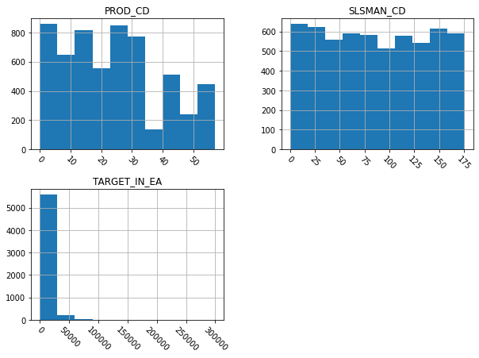
Graphs:
Right skewed therefore we can say it must have outliers for PROD_CD.
Here on SLSMAN_CD most of the data's having same slight frequencies.
Right skewed outliers are there for TARGET_IN_EA.

Slide 12
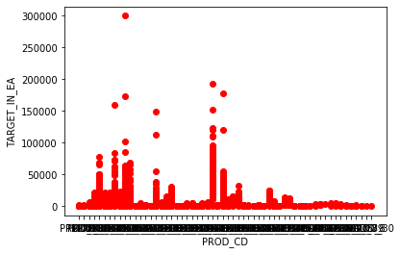
Represent "product code" in x label and "TARGET_IN_EA" in y label and see the scatter plot in the form of bar plot.

Slide 13
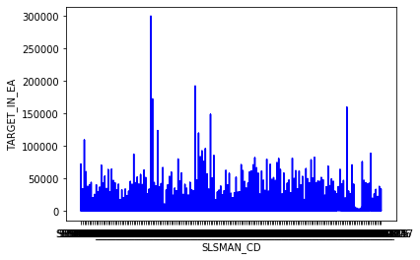
Scatter plot for "TARGET_IN_EA" and “SLSMAN_CD" , whereas Y label is "TARGET_IN_EA" and " SLSMAN_CD " as X label

Slide 14
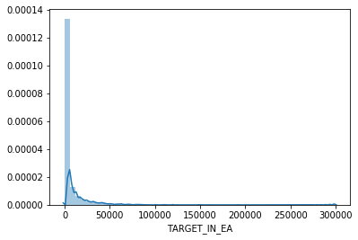
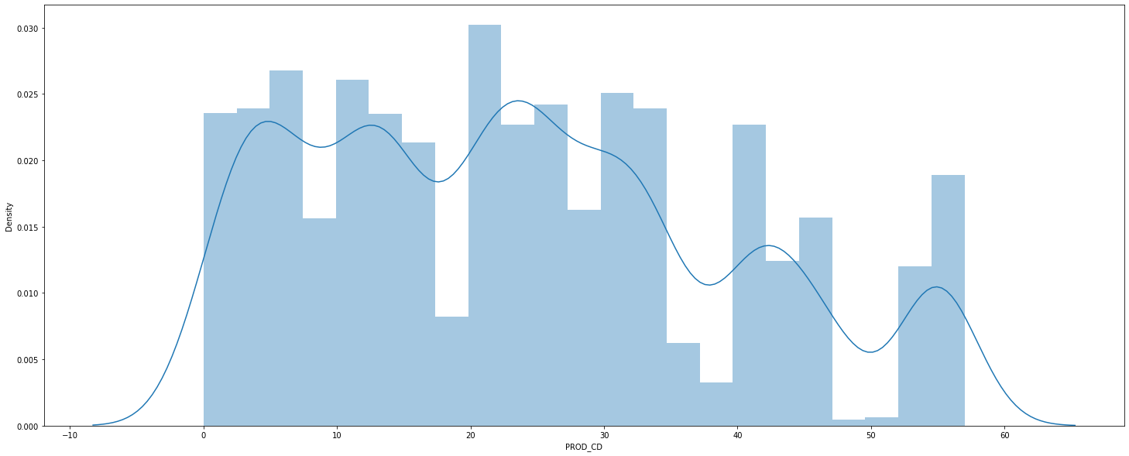
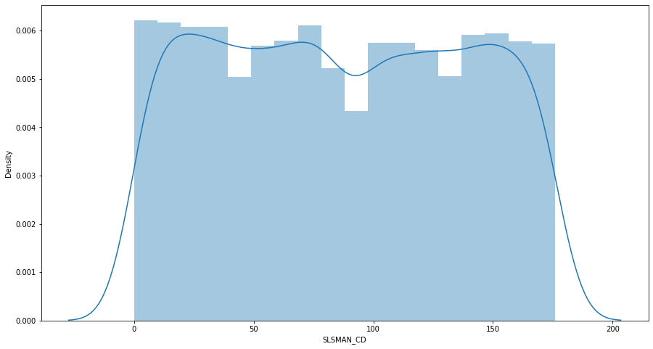
DISTRIBUTION PLOTS

Slide 15
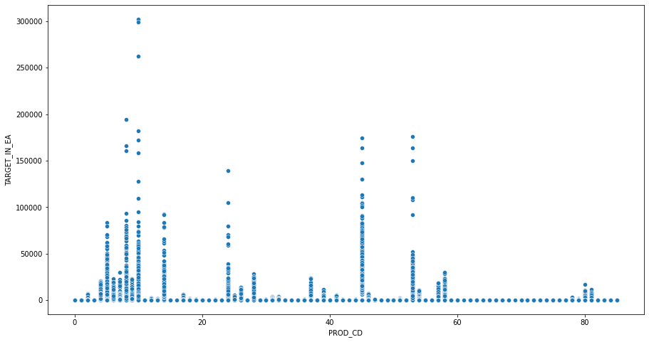
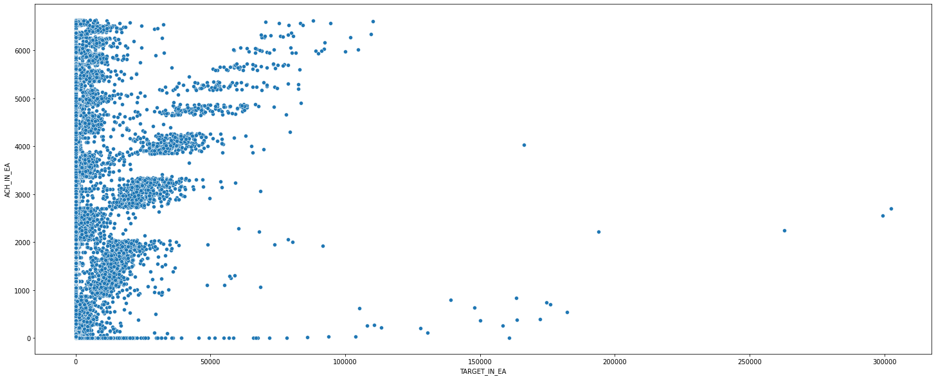
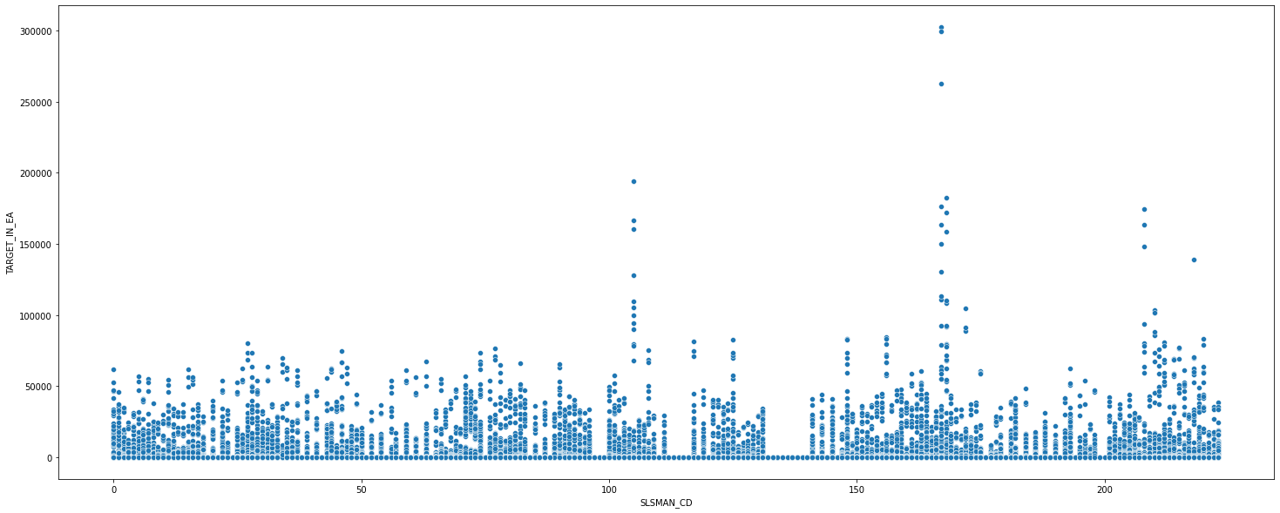
SCATTER PLOTS

Slide 16
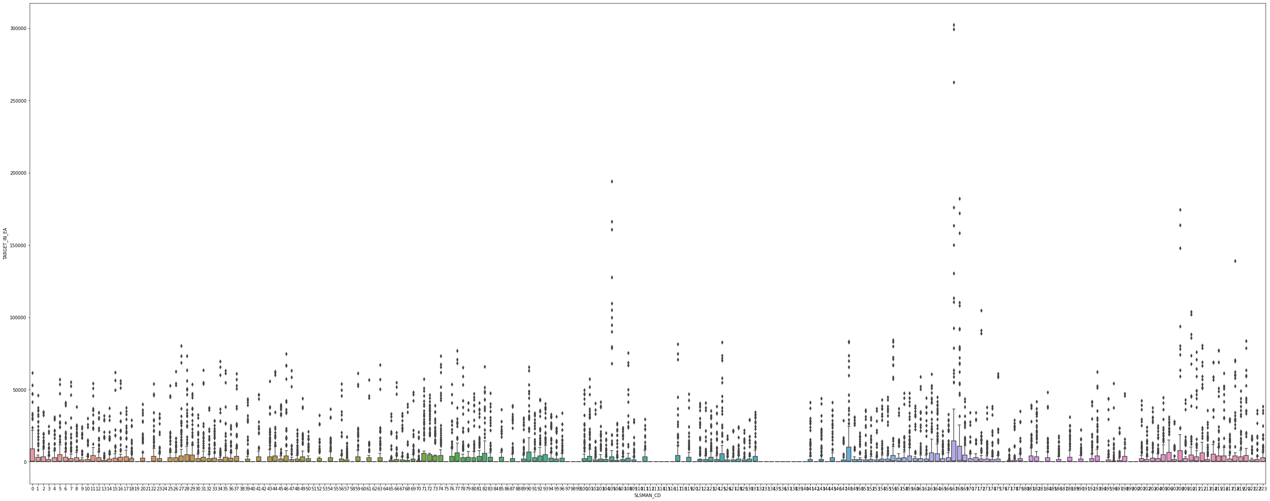
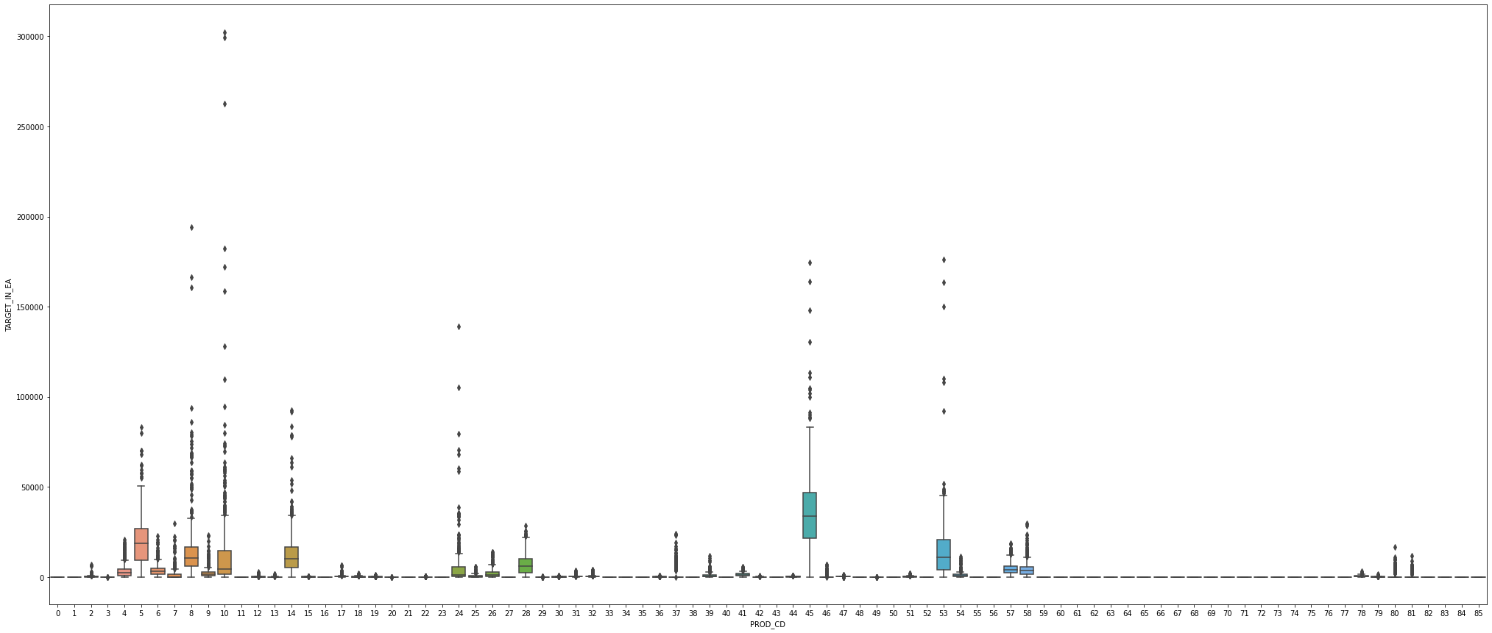
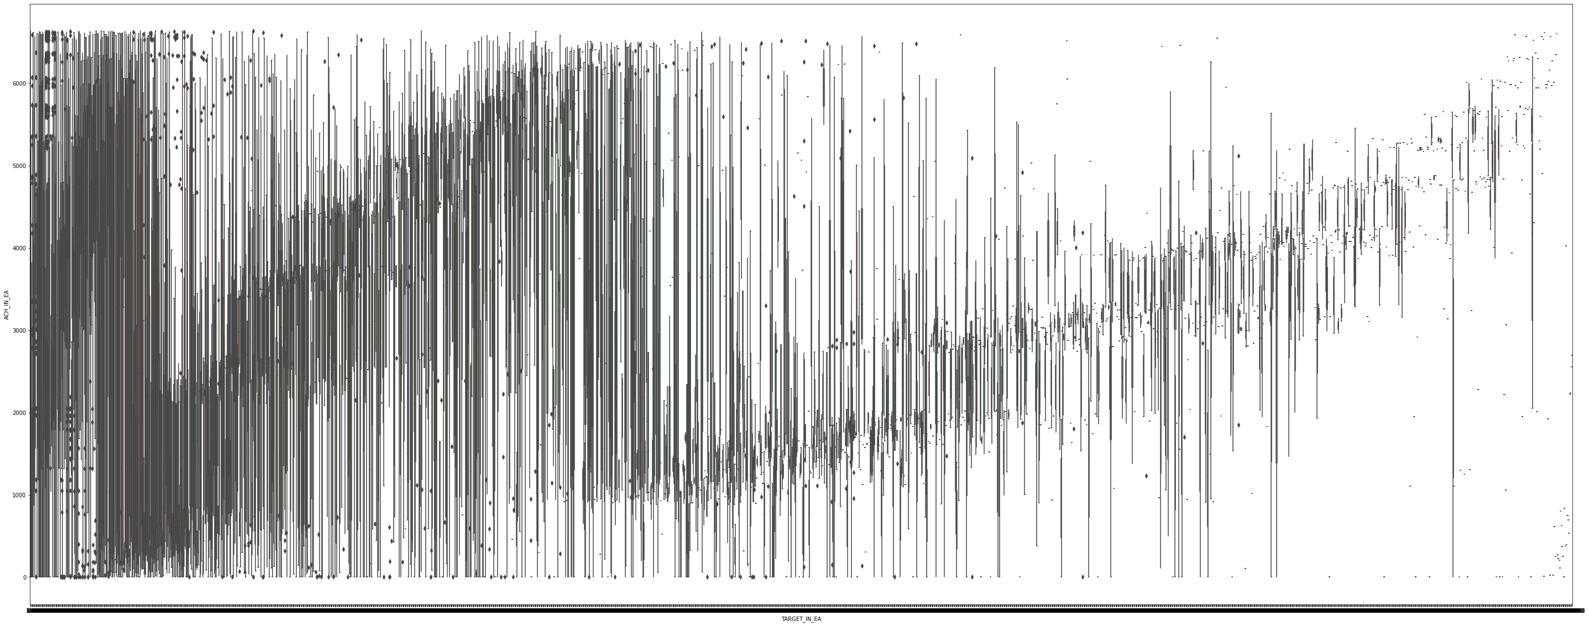
BOX PLOTS

Slide 17
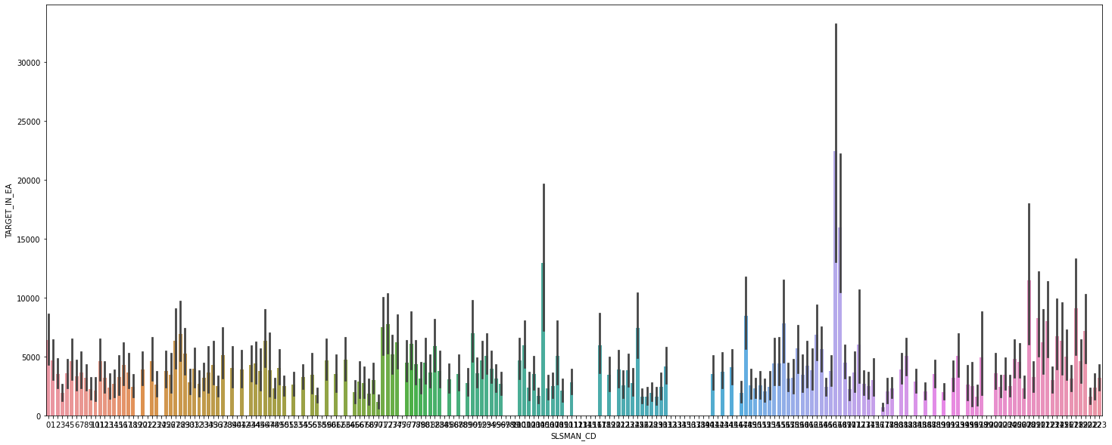
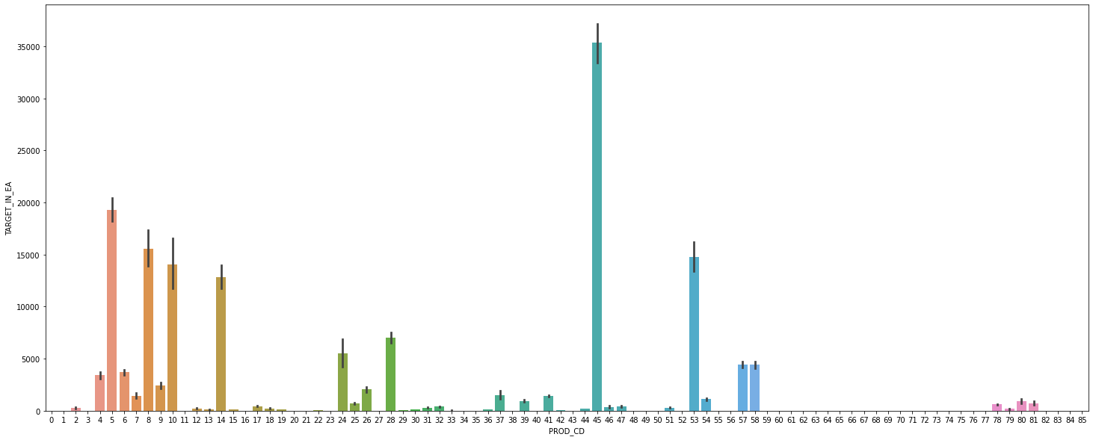
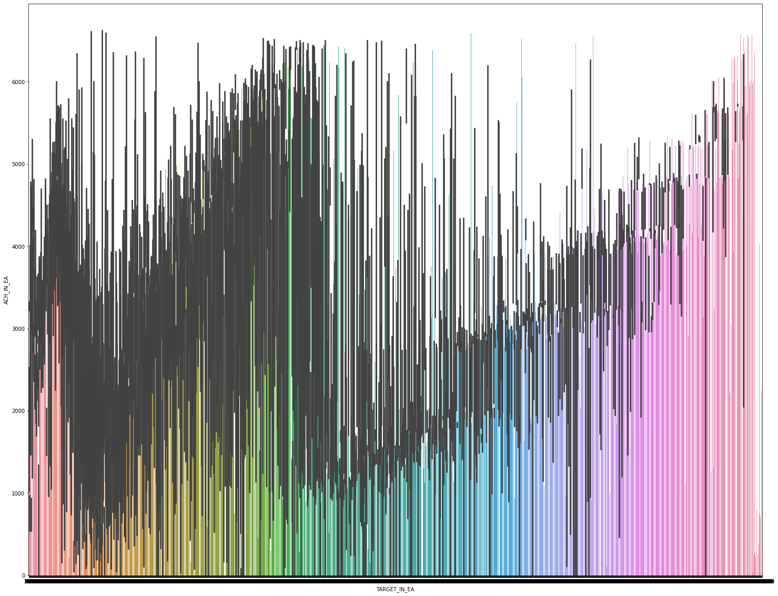
BAR PLOTS

Slide 18
Model Building

Slide 19
MoDels Built
Random Forest with RandomizedSearchCV
LightGBM
XGBClassifier

Slide 20
Random Forest with RandomizedSearchCV
Training Score – 99.28%
Testing Score – 88.47%
RMSE – 0.0512

Slide 21
LightGBM
Training Score – 99.85%
Testing Score – 88.32%
RMSE – 0.05

Slide 22
Random Forest with RandomizedSearchCV
Training Score – 82.28%
Testing Score – 73.56%
RMSE – 182.75

Slide 23
Model Deployment

Slide 24
Model Deployment is in Process…

Slide 25
Thank You!
Vimal
Nilesh Sinkar
Niraj Mohabey
Punya
Akshay Chopade

